Slide 1
ANALYTICS PRACTICUM INTUILIZE GROUP 1

Slide 2
Index
Our Mission
Data Journey
Customer Segments
Most Impactful Stock Codes
Price Elasticity Analysis
Inventory Analysis
Q & A

Slide 3

Our Mission
Current gross margin: Approximately 14%
Assumption: A healthy margin for this business is 20+%

Slide 4

Make Data Useful
Clean the data
Removed Products with No Cost
Removed Extreme Outliers (7 Records)
Fixed Incorrect Dates (Feb 29, 2018 -> Feb 28, 2018)

Slide 5

Most Important Customers?

Slide 6
Customer Segments – RFM Analysis
 | Size (%) | Margin (%) | Recency | Frequency | Monetary
VIP | 1.6% | 44.2% | - | - | -
Star | 10.1% | 35.1% | 1 | 1 | 1
Core | 63.7% | 24.3% | 1 – 4 | 1 – 4 | 2 or 3
Drain | 24.6% | -3.6% | 1 – 4 | 1 – 4 | 4
Top 11.7% customers bring 79.3% total margin
Bottom 25% customers decrease total margin
Notes:
We seperated 65 VIP customers and then we conducted RFM analysis. Star segment has score 111 and Drain segment has score 4 from Monetary.
As Kelly mentioned earlier about 80/20 rule, about 12% customers bring 80% total margin and drain segment decreases about 4% of total margin

Slide 7
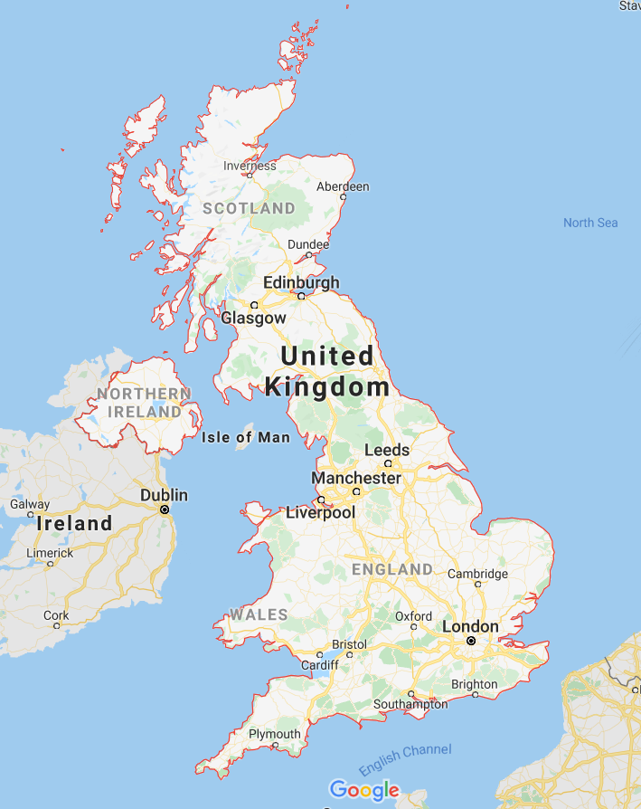
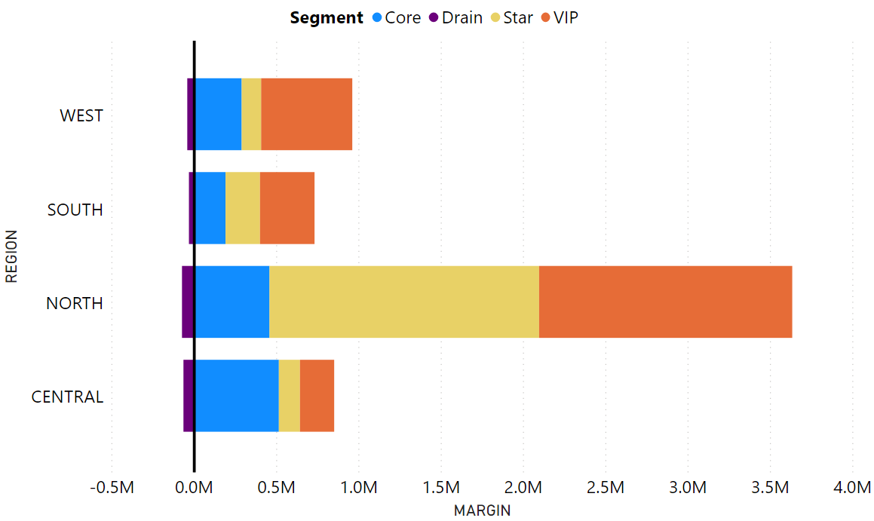
Country & Region
90% of customer is from United Kingdom
Most margin is from North region in UK
Notes:
90% of customer is from United Kingdom
and as you can see on the right chart, most margin is from North region in United Kingdom

Slide 8
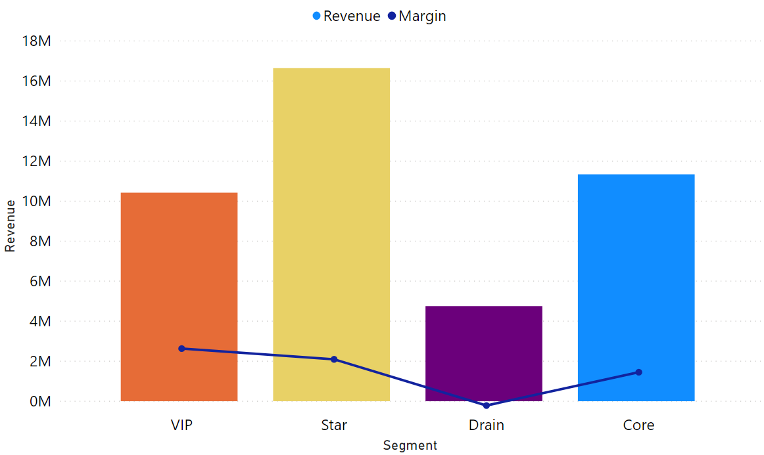
Revenue & Margin
Drain segment’s margin is negative Even though their revenue is almost half of VIP segment
Notes:
This is revenue and margin chart, Bar chart represent the revenue and the line chart represent the margin
Drain segment’s revenue is almost half of VIP, however their margin is negtaive

Slide 9
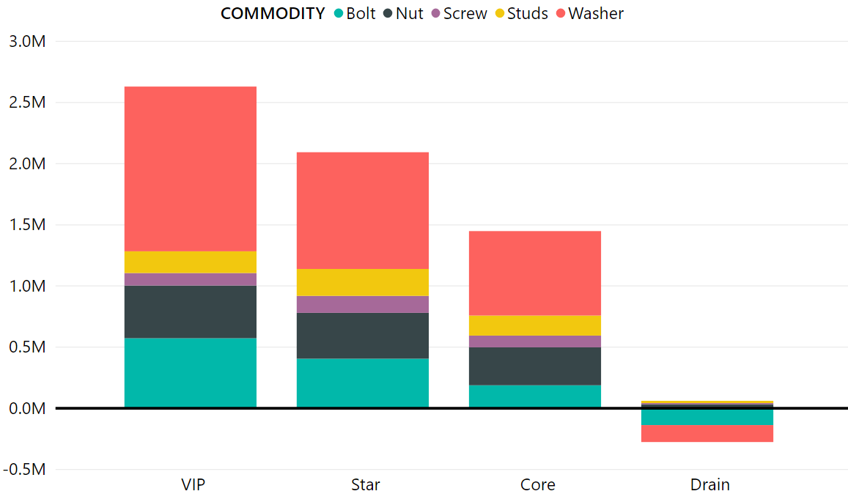
Top Margin Products
Highly impactful products = Washer / Nut / Bolt
Drain segment decreases total margin from Washer / Bolt
Notes:
This is top margin products chart. Washer, nut, bolt have large impact to our total margin
And Washer and Bolt are the main products that decrease the total margin in Drain segement

